Slide 1
PROFESSIONAL ETHICS
LECTURE # 1

Slide 2


WHAT IS IT?

Slide 3


Can you relate?

Slide 4
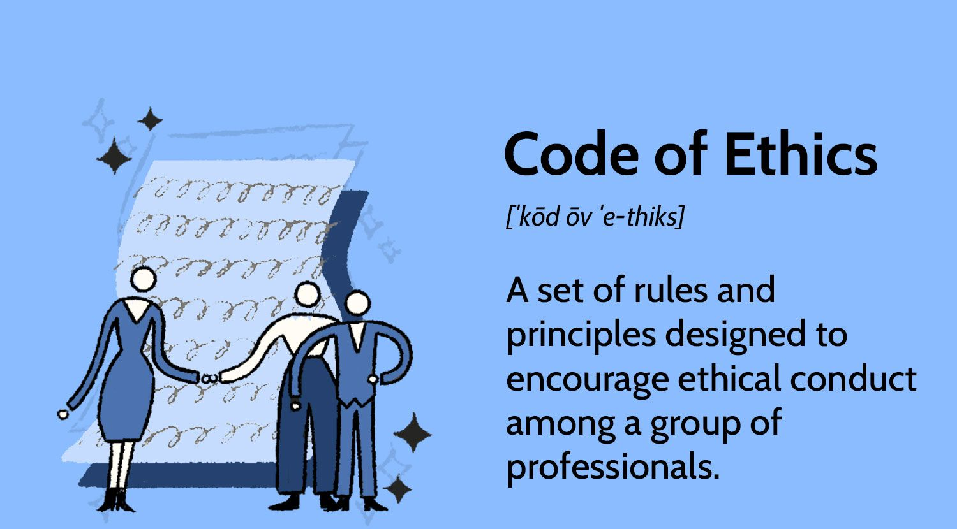
Definition

Slide 5

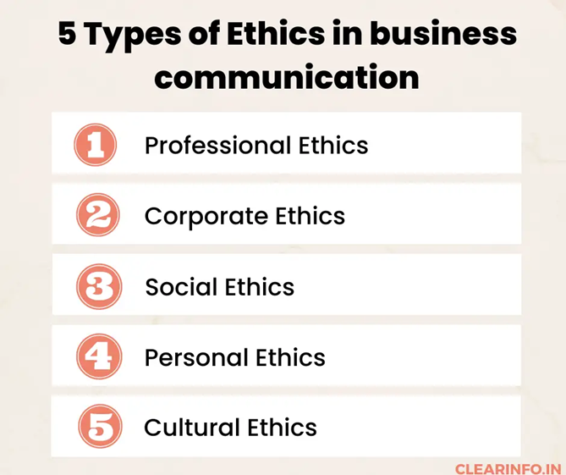
Types of ethics
ppccs

